Slide 1
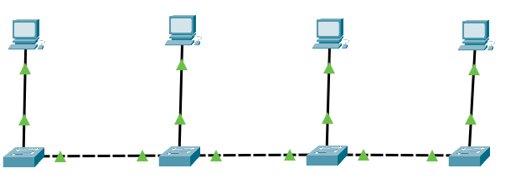
Lab 7A – Create a Physical Network with VLANs
DESK 11 DESK 12 DESK 13 DESK 14
192.168.10.11 192.168.10.12 192.168.10.13 192.168.10.14
F0/1
F0/2
F0/3
F0/4
G0/2
G0/1
G0/2
G0/1
G0/2
G0/1
Access_11 Access_12 Access_13 Access_14
In this lab we are going to create a VLAN topology using the racked switches. Follow directions carefully and test connections/configurations after each step to isolate problems early! Note we have 6 groups of desks; the instructions are for desks 11-14, follow the same convention for other desks. 11,12,13,14 21,22,23,24 31,32,33,34 41,42,43,44 51,52,53,54 61.62,63,64

Slide 2
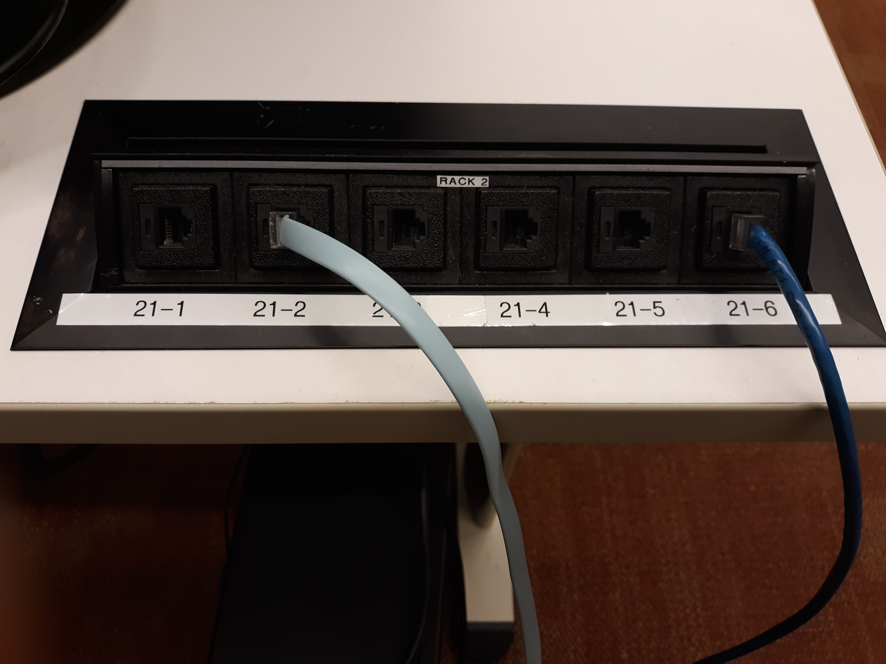
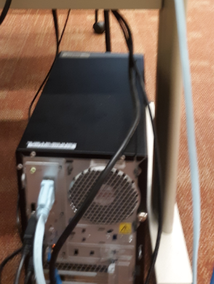
Step 1 – Console into your switch and reset
DESK 11 DESK 12 DESK 13 DESK 14
Access_11 Access_12 Access_13 Access_14
Console into your switch – Table Port 2 to PC serial port
Run Putty (select SERIAL port) & hit enter
Do NOT run the “initial configuration dialog”!
"SHOW FLASH" – if VLAN.DAT is present: "DELETE VLAN. DAT“ (in enable mode)
"WRITE ERASE" – what does this command do?
"RELOAD"
For manual reload of switch: Hold MODE Button > 3 seconds. LED's start blinking. Continue holding button until blinking stops.

Slide 3
Step 2 – Configure your switch
DESK 11 DESK 12 DESK 13 DESK 14
Access_11 Access_12 Access_13 Access_14 Access_21 Access_22 Access_23 Access_24 Access_31 Access_32 Access_33 Access_34 Access_41 Access_42 Access_43 Access_44 Access_51 Access_52 Access_53 Access_54 Access_61 Access_62 Access_63 Access_64
Name the switch “Access_##” where ## is your workstation number
Set the banner message to “This switch configured by yourname!”
Configure so that any invalid commands entered won’t be assumed to be an IP address
Empty the MAC address table
Set the CLOCK timezone to “NYT” 5 hours less than UTC
Turn off CDP for the switch

Slide 4
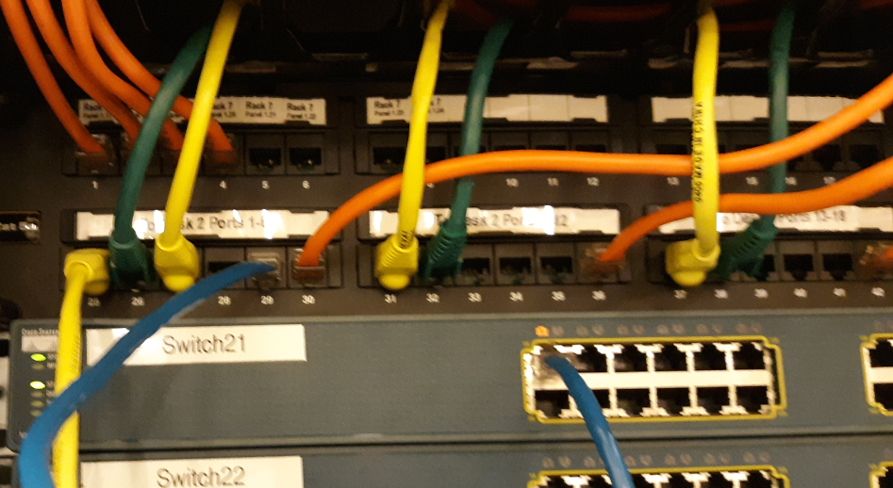
Step 3 – Connect your PC to the network via a PORT
DESK 11 DESK 12 DESK 13 DESK 14
192.168.10.11 192.168.10.12 192.168.10.13 192.168.10.14
F0/1
F0/2
F0/3
F0/4
Rack Port 5
Access_11 Access_12 Access_13 Access_14
Disable the current Ethernet adapter
Enable Ethernet 2 – and configure your IP address as 192.168.10.##
Connect Ethernet cable from table port 5 to PC’s second Ethernet port
Connect Ethernet cable from Rack port 5 To switch port X (ex table 31 to 1, 32 to 2, 33 to 3, 34 to 4.
Ensure status light turns green!
Ping your own IP address! (may need time)
Label F0 ports either “Unused” or “Desk_##”
Shutdown unused F0 ports
Switch Ports

Slide 5
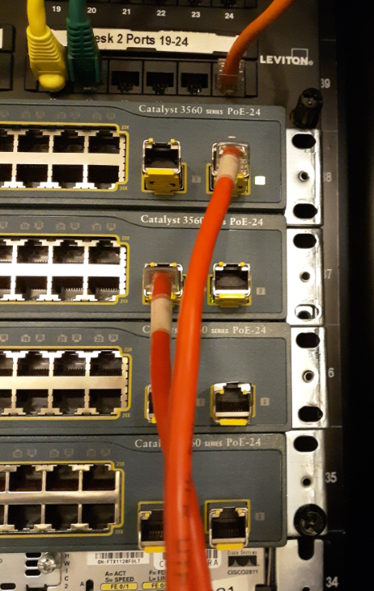
Step 4 – Connect switches together
DESK 11 DESK 12 DESK 13 DESK 14
192.168.10.11 192.168.10.12 192.168.10.13 192.168.10.14
F0/1
F0/2
F0/3
F0/4
G0/2
G0/1
G0/2
G0/1
G0/2
G0/1
Access_11 Access_12 Access_13 Access_14
Cable switch to switch with GigabitEthernet cable G/02 to G0/1
Ensure status lights turn green!
SHOW INTERFACES STATUS
Ping every device on the network

Slide 6
Step 5 – Create two VLAN’s
DESK 11 DESK 12 DESK 13 DESK 14
192.168.10.11 192.168.10.12 192.168.10.13 192.168.10.14
F0/1
F0/2
F0/3
F0/4
G0/2
G0/1
G0/2
G0/1
G0/2
G0/1
Access_11 Access_12 Access_13 Access_14
Create VLANs 10 (“1and3”) and 20 (“2and4”)
Assign Desks #1 and #3 to VLAN 10
Assign desks #2 and #4 to VLAN 20
Configure trunk ports. Note to configure trunk mode you need to “SW TRUNK ENCAPS DOT1Q” What does that command do?
Ping Desk #1 to Desk #3
Ping Desk #2 to Desk #4

Slide 7
Step 6 – Lab Completion checklist
Ensure all the below items are working, then have show professor:
SHOW INT STATUS - unused ports are labeled “UNUSED” and are shutdown
SHOW CDP – CDP is disabled
SHOW VLAN – VLANs 10 and 20 are created and desk port is in the correct VLAN
PING to other desk in your VLAN works
PING to other desks NOT in your VLAN timeout
NAME : ________________________________ DESK ##: ____________ YOUR VLAN : ________________
AFTER ALL TABLE DESKS HAVE BEEN VERFIED: 1. Erase the VLAN.DAT file and RELOAD switch
2. Uncable
2. DISABLE second ETHERNET adapter and ENABLE original adapter 3. Ensure your workstation has Internet access
4. Restart the workstation

